Slide 1
Employee Data Analysis using Excel
STUDENT NAME: J. STELLA EPSHIBA
REGISTER NO: 2201111036071
NM ID: DE6F9E368E2A188AF9A40B1C048B1B67
DEPARTMENT: B.COM (GENERAL)
COLLEGE: L. N. GOVERNMENT COLLEGE (AUTONOMOUS)

Slide 2
PROJECT TITLE
EMPLOYEE PERFORMANCE ANALYSIS USING EXCEL

Slide 3


AGENDA
Problem Statement
Project Overview
End Users
Our Solution and Proposition
Dataset Description
Modelling Approach
Results and Discussion
Conclusion
3/21/2024 Annual Review

Slide 4

PROBLEM STATEMENT
Lack of Insights
Limited understanding of employee performance trends and patterns due to inefficient data analysis methods.
Ineffective Performance Management
Difficulty in identifying areas for improvement and providing targeted development opportunities
Suboptimal Resource Allocation
Challenges in allocating resources effectively based on employee performance data.
Data-Driven Decision Making
Need for a more robust approach to analyzing employee data to support informed decision-making.

Slide 5







PROJECT OVERVIEW
Data Collection
Gathering employee performance data from various sources.
Data Cleaning and Preparation
Ensuring data quality and consistency for accurate analysis.
Data Analysis
Using Excel functions and features to analyze employee performance data.
Visualization
Creating charts and graphs to visually represent the analysis results.
Report Generation
Presenting the analysis findings in a clear and concise report.
Recommendations
Developing actionable recommendations based on the analysis results.

Slide 6

WHO ARE THE END USERS?
Human Resources (HR)
Managers
Employees
HR professionals can use the analysis to understand employee performance trends and develop effective HR policies.
Managers can use the analysis to identify areas for improvement in their teams and provide targeted support to individual employees.
Employees can benefit from the analysis by gaining insights into their own performance and identifying areas for development.

Slide 7

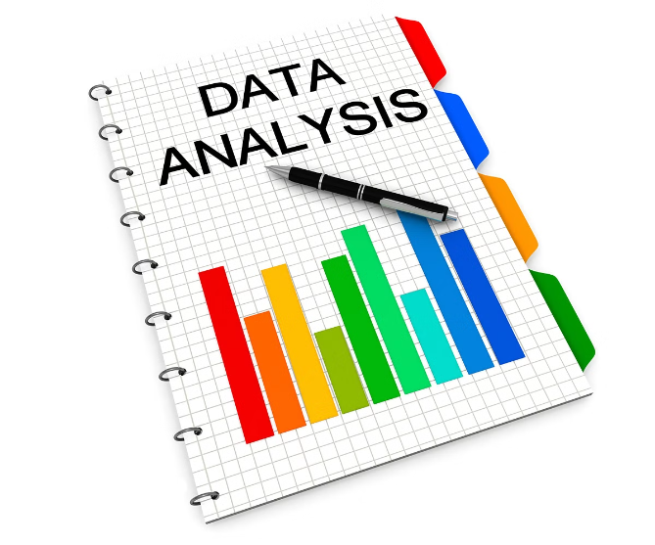



OUR SOLUTION AND ITS VALUE PROPOSITION
Data-Driven Insights
Provides deeper insights into employee performance, revealing hidden patterns and trends.
Targeted Development
Enables managers to identify specific areas where employees need support and development.
Strategic Decision Making
Supports informed decision-making regarding resource allocation, performance management, and talent development..
Improved Performance
Contributes to an overall increase in employee performance and productivity.

Slide 8
Dataset Description
Variable | Description | Data Type
Employee ID | Unique identifier for each employee | Numeric
Name | Employee’s full name | Text
Department | Employee’s department | Text
Job Title | Employee’s job position | Text
Performance Rating | Numerical rating based on performance review | Numeric
Years of Experience | Number of years working at the company | Numeric
Training Hours | Total hours of training received | Numeric
Salary | Employee’s annual salary | Numeric

Slide 9
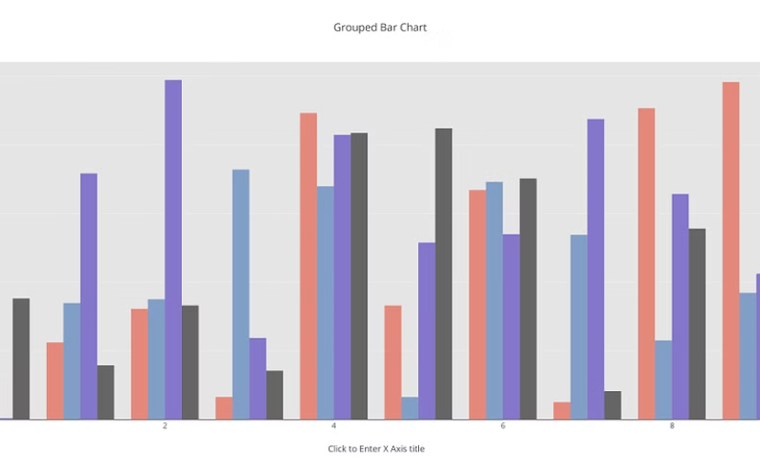
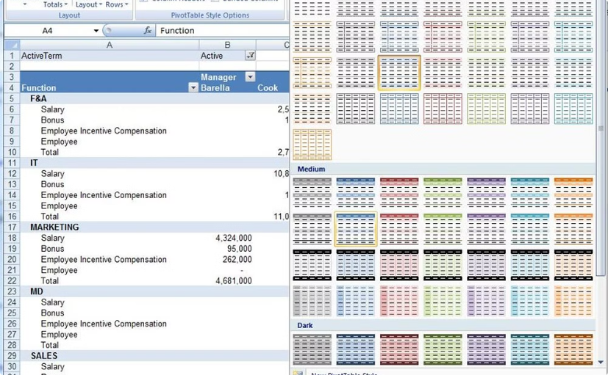

THE "WOW" IN OUR SOLUTION
Interactive Dashboard
Pivot Table Analysis
Create a dynamic dashboard in Excel that allows users to interact with the data and explore different views.
Use pivot tables to summarize and analyze data quickly and effectively, allowing for drill-down capabilities.
3/21/2024 Annual Review
9

Slide 10
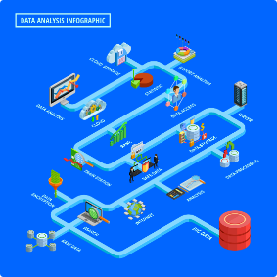
MODELLING
Descriptive Analysis
Correlation Analysis
1
2
Calculate descriptive statistics such as mean, median, standard deviation, and quartiles to summarize the data.
Examine the relationships between different variables using correlation coefficients to identify potential drivers of performance.
3
Regression Analysis
4
Data Visualization
Develop regression models to predict employee performance based on relevant factors.
Create charts and graphs to visually represent the analysis results and communicate insights effectively.
10

Slide 11
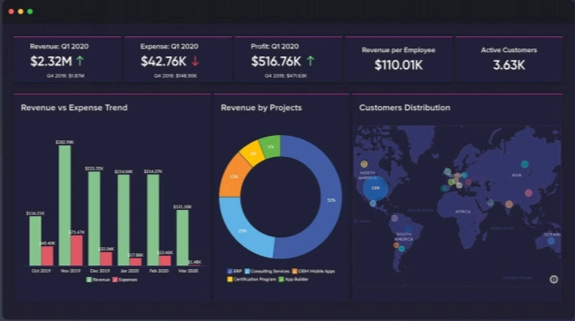
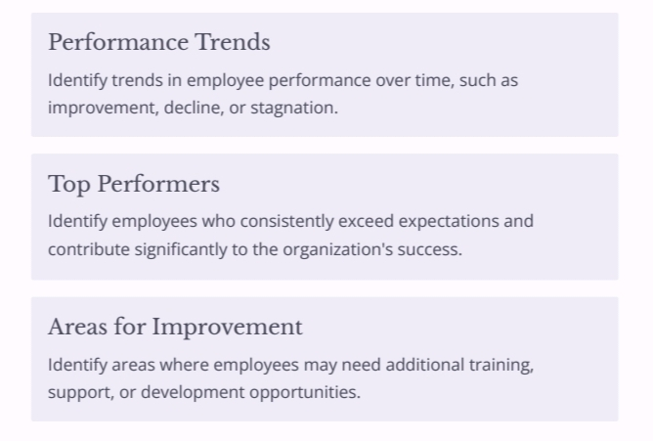
RESULTS
11

Slide 12

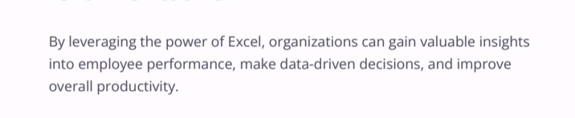
conclusion

